Slide 1
The Key
influencer
The Key influencer

Slide 2
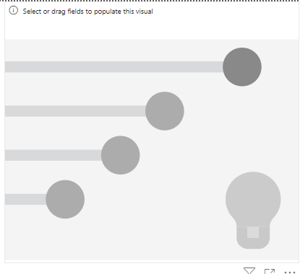
The Key influencer
Note: This lab is based on the excel file customerfeedback.xlsx in Excel Sources
Add a Key influencer visual to the scene

Slide 3
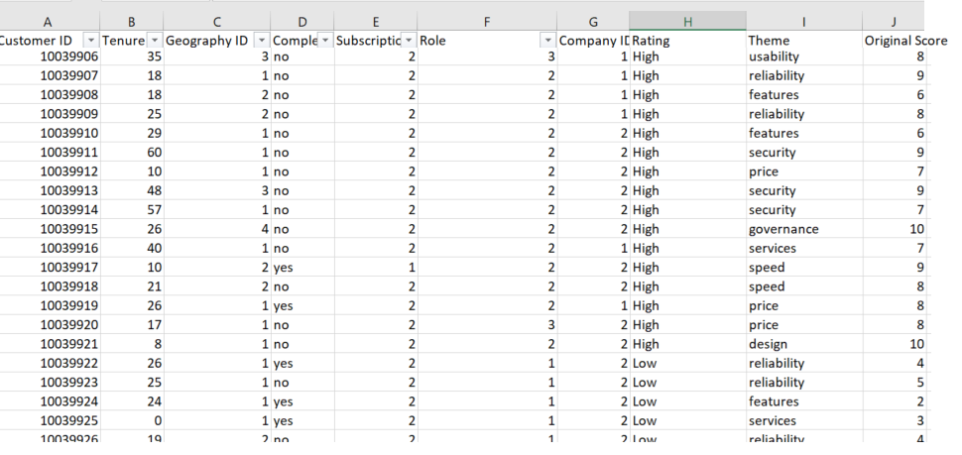
The Key influencer
We will study the impact of several factor of the customer rating High or Low

Slide 4
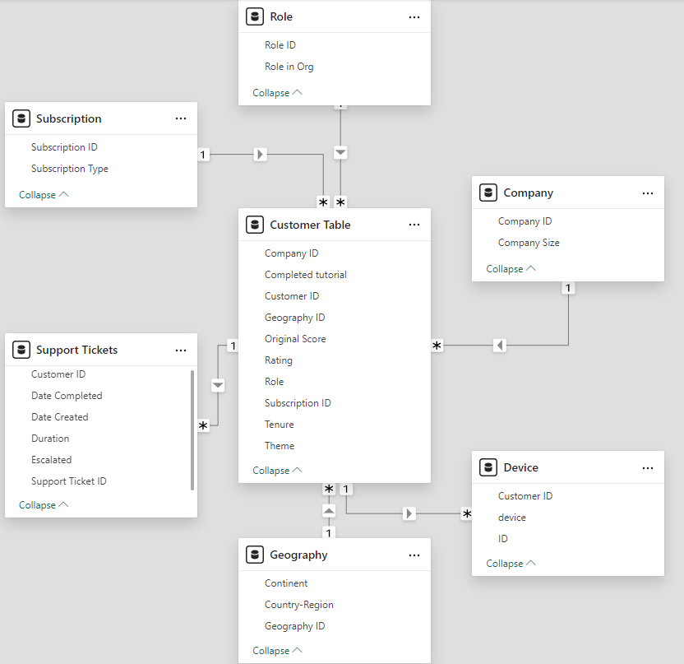
The Key influencer
We will study the impact of several factor of the customer rating High or Low

Slide 5
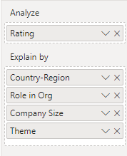
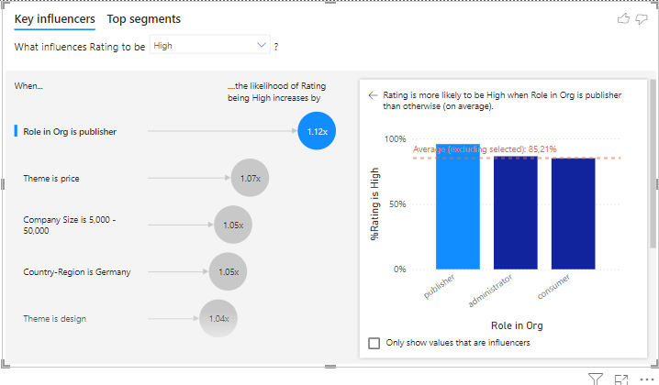
The Key influencer
Add Rating to Analyse and then Country-Region, Role in Org, Company Size and Theme to Explain by and
observe the change

Slide 6
The Key influencer
Role in Org as "Publisher":
The Key Influencers chart shows that being a Publisher increases the likelihood of a high rating by 1.12x.
The bar chart validates this, showing 85.21% high ratings for Publishers, which is higher than the average.
Insight: Publishers have a significant positive impact on high ratings.
Recommendation: Focus on engaging and retaining Publishers as they contribute most to high ratings.

Slide 7
The Key influencer
Themes:
Themes such as Price and Design have modest positive impacts (1.07x and 1.04x, respectively).
Insight: These factors slightly boost satisfaction, indicating areas to refine further.
Recommendation: Highlight competitive pricing and improve design elements to reinforce satisfaction.

Slide 8
The Key influencer
Regions and Company Size:
Germany and company size (5,000-50,000) contribute a 1.05x likelihood of high ratings.
Insight: These characteristics define segments that are more likely to provide positive feedback.
Recommendation: Tailor strategies to maintain satisfaction in Germany and mid-sized companies.

Slide 9
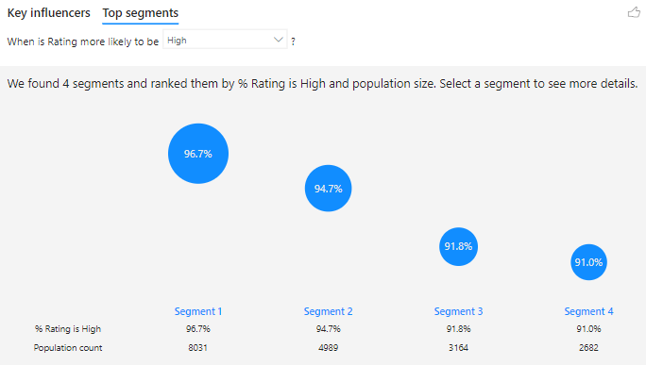
The Key influencer
Analyze Top Segments for High Rating
Segments are ranked by the percentage of high ratings and population size.
Segment 1 (96.7% high rating, population: 8,031) represents the most satisfied group, followed by other segments with slightly lower ratings (94.7%-91.0%).
Insight: Segment 1 is the most significant driver of high ratings due to its size and high satisfaction rate.
Recommendation: Identify characteristics of this segment and replicate its conditions across other groups.

Slide 10
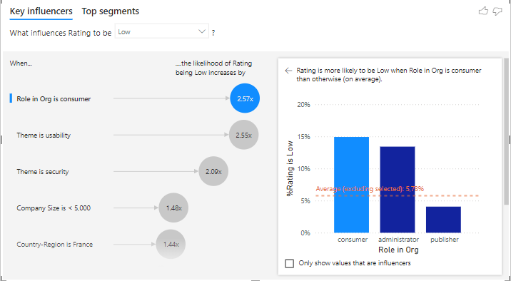
The Key influencer
Role in Org as "Consumer":
The chart indicates Consumers are 2.57x more likely to give low ratings. The bar chart shows Consumers exceed the average percentage of low ratings (5.78%).
Insight: Consumers are the most dissatisfied group.
Recommendation: Investigate their challenges and prioritize resolving their pain points.

Slide 11
The Key influencer
Themes and company sizes :
Usability and Security issues significantly influence low ratings (2.55x and 2.09x, respectively).
Smaller companies (<5,000 employees) are 1.48x more likely to provide low ratings.
Insight: Usability and Security are key dissatisfaction drivers, especially for smaller companies.
Recommendation: Improve usability and security aspects, targeting smaller businesses.

Slide 12
The Key influencer
Regions:
France is 1.44x more likely to yield low ratings.
Insight: Regional dissatisfaction may be linked to localized factors.
Recommendation: Investigate and address specific regional concerns, especially in France.

Slide 13
The Key influencer
Analyze Top Segments for High Rating
Segments are ranked by the percentage of high ratings and population size.
Segment 1 (96.7% high rating, population: 8,031) represents the most satisfied group, followed by other segments with slightly lower ratings (94.7%-91.0%).
Insight: Segment 1 is the most significant driver of high ratings due to its size and high satisfaction rate.
Recommendation: Identify characteristics of this segment and replicate its conditions across other groups.

Slide 14
Thank you
Thank you

